Slide 1
.NET Tutorial

Slide 2
Microsoft .NET
.NET is the Microsoft Web services strategy to connect information, people, systems, and devices through software.
Integrated across the Microsoft platform, .NET technology provides the ability to quickly build, deploy, manage, and use connected, security-enhanced solutions with Web services.
.NET was originally called NGWS (Next Generation Windows Services).
Web services are self-describing software modules, semantically encapsulating discrete functionality, wrapped in and accessible via standard Internet communication protocols such as XML and SOAP.

Slide 3
Microsoft .NET
The Microsoft. NET strategy was presented in June 2000:
  .NET is Microsoft's new Internet and Web strategy
  .NET is NOT a new operating system
  .NET is a new Internet and Web based infrastructure
  .NET delivers software as Web Services
  .NET is a framework for universal services
  .NET is a server centric computing model
  .NET will run in any browser on any platform
  .NET is based on the newest Web standards
The motivations driving this vision are:
  Object-oriented programming
  Compiled once and run everywhere
  Service-oriented application

Slide 4
.NET Standard
A standard distributed application should run on almost any computer in the world. .NET have been standardized by ECMA (http://www.ecma-international.org/).
Clients must be Standard Internet Browsers.
  All clients use standard Internet browsers like Firefox, Internet Explorer, or Netscape running on Windows, Linux, or Mac computers.
Servers must be Standard Internet Servers.
  Standard Internet servers such as Apache, Tomcat, or Internet Information Services (IIS).
Applications must use Internet Communication
  Servers should be requested with standard stateless Internet HTTP requests. Servers should respond with a standard stateless Internet HTTP response.

Slide 5
.NET Infrastructure
.NET Infrastructure
  Development Tools: The .NET framework is a programming environment.
  Web Services: .NET provides a standard syntax for the language defined for sites providing web services.
  Specialized servers (.NET servers): Severs that work with .NET such as SQL Server 2000 is described as .NET enabled.
  Devices that are running on .NET.
.NET implementation
  Windows: Microsoft .NET
  Linux: Mono, DotGNU
  MacOS X: Mono

Slide 6
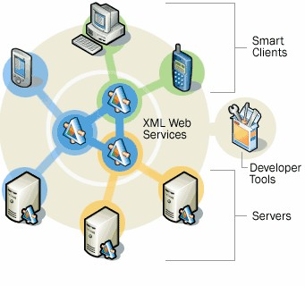
.NET Infrastructure
Development Tools
Web services
Specialized servers
Clients

Slide 7
.NET Framework
The .NET Framework is a common environment for building, deploying, and running Web Services and Web Applications (Microsoft JDK?). It contains:
  The Common Language Runtime,
  The .NET Framework Classes, and
  higher-level features like ADO.NET, ASP.NET and Window Forms for developing desktop applications.
The Common Language Runtime (CLR) (Microsoft JRE?) manages the execution of code compiled for the .NET platform. The CLR has two features:
  Its specification has been opened up so that it can be ported to non-Windows platforms.
  Any number of different languages can be used to manipulate the .NET framework classes, and the CLR will support them.

Slide 8
.NET Framework Standard
The CLI (Common Language Infrastructure) is the definition of the fundamentals of the .NET framework:
  the Common Type System (CTS) and metadata,
  the Virtual Execution Environment (VES) and
  its use of intermediate language (IL), and
  the support of multiple programming languages via the Common Language Specification (CLS).
The CLI is documented through ECMA - see http://msdn.microsoft.com/net/ecma/ for more details.
The CLR (Common Language Runtime) is Microsoft's primary implementation of the CLI.

Slide 9
.NET Framework
The Common Language Runtime – An execution environment providing
  Garbage collection
  Security
  Exception Handling
  Multithreading
  Memory Management
  Type Safety
The .NET Framework Classes
  A collection of reusable classes
  Classes grouped into logical collections, called namespaces like System.IO
  Classes grouped into physical collections, called assemblies like System.IO.dll

Slide 10
.NET Framework
ADO.NET
  A disconnected programming environment for working with data sources
  Ability to create a pseudo database with tables and relationships in your applications to hold cached copies of data from different sources
  Support for XML
ADO.ASP
  As easy to create Web Applications as it is to create Windows Applications
  Full power of a programming language such as VB.NET and C# compared to VBScript in ASP 2.0
  Many new features which previous ASP 2.0 programmers had to code themselves

Slide 11
.NET Framework
The .NET Framework is language neutral.
  Currently it supports C++, C#, Visual Basic, JScript (The Microsoft version of JavaScript) and COBOL.
  Third-party languages such as Eiffel, Perl, Python and others are also available for building future .NET Framework applications.
Not all of the supported languages fit entirely neatly into the .NET framework.
The Visual Studio.NET is a common development environment for the new .NET Framework.
  It provides a feature-rich application execution environment, simplified development and easy integration between a number of different development languages.

Slide 12
.NET Framework
VB
C++
C#
JScript
…
Visual Studio.NET
Common Language Specification
ASP.NET
Windows Forms
ADO.NET and XML
Base Class Library
Common Language Runtime
Windows
COM+ Services
Notes:
Asp.net: web service and web forms

Slide 13
.NET Software
Windows .NET
  Windows XP form the backbone of .NET.
  Windows .NET is the new generation Windows. It will provide support for all the .NET building blocks and .NET digital media.
  Windows .NET will be self-supporting with updates via Internet as users need them.
Office .NET
  A new version of Microsoft Office - Office .NET - will have a new .NET architecture based on Internet clients and Web Services.
  With Office .NET, browsing, communication, document handling and authoring will be integrated within a XML-based environment which allow users to store their documents on the Internet.

Slide 14
.NET Software
Active Server Pages - ASP .NET is the latest version of ASP. It includes Web Services to link applications, services and devices using HTTP, HTML, XML and SOAP. New in ASP .NET:
  New Language Support
  Programmable Controls
  Event Driven Programming
  XML Based Components
  User Authentication
  User Accounts and Roles
  High Scalability
  Compiled Code
  Easy Configuration
  Easy Deployment
  Not ASP Compatible
  Includes ADO .NET

Slide 15
.NET Software
What is ADO?
  ADO is a Microsoft technology
  ADO stands for ActiveX Data Objects
  ADO is a Microsoft Active-X component
  ADO is automatically installed with Microsoft IIS
  ADO is a programming interface to access data in a database
ADO.NET is the next evolutionary step in data access technology. Employing the aforementioned ADO technology, ADO.NET expands this by incorporating XML into a standard model to not only relational data models but also text based XML data.

Slide 16
.NET Software
Visual Studio .NET
  The latest version of Visual Studio - Visual Studio .NET - incorporates ASP .NET, ADO .NET, Web Services, Web Forms, and language innovations for Visual Basic.
  The development tools have deep XML support, an XML-based programming model and new object-oriented programming capabilities.
Visual Basic .NET
  Visual Basic .NET has added language enhancements, making it a full object-oriented programming language.

Slide 17
.NET Web Services
What are Web Services?
  Web services are small units of code
  Web services are designed to handle a limited set of tasks
  Web services use XML based communicating protocols
  Web services are independent of operating systems
  Web services are independent of programming languages
  Web services connect people, systems and devices
Small Units of Code
  Web services are small units of code designed to handle a limited set of tasks.
  An example of a web service can be a small program designed to supply other applications with the latest stock exchange prices. Another example can be a small program designed to handle credit card payment.

Slide 18
.NET Web Services
XML Based Web Protocols
  Web services use the standard web protocols HTTP, XML, SOAP, WSDL, and UDDI.
HTTP
  HTTP (Hypertext Transfer Protocol) is the World Wide Web standard for communication over the Internet. HTTP is standardized by the World Wide Web Consortium (W3C).
XML
  XML (eXtensible Markup Language) is a well known standard for storing, carrying, and exchanging data. XML is standardized by the W3C.

Slide 19
.NET Web Services
SOAP
  SOAP (Simple Object Access Protocol) is a lightweight platform and language neutral communication protocol that allows programs to communicate via standard Internet HTTP. SOAP is standardized by the W3C.
WSDL
  WSDL (Web Services Description Language) is an XML-based language used to define web services and to describe how to access them. WSDL is a suggestion by Ariba, IBM and Microsoft for describing services for the W3C XML Activity on XML Protocols.
UDDI
  UDDI (Universal Description, Discovery and Integration) is a directory service where businesses can register and search for web services.

Slide 20
.NET Servers
SQL Server
  SQL Server is a fully web-enabled database.
  SQL Server has strong support for XML and HTTP which are two of the main infrastructure technologies for .NET.
  Some of the most important new SQL Server features are direct access to the database from a browser, query of relational data with results returned as XML, as well as storage of XML in relational formats.
  The current version is SQL Server 2000. SQL Server 2005 is going to be released soon.
Internet Information Services
  IIS has strong support for more programming to take place on the server, to allow the new Web Applications to run in any browser on any platform.
  The current version is SQL IIS 6.0.

Slide 21
.NET Servers
Internet Storages
  .NET offers secure and addressable places to store data and applications on the Web. Allowing all types of Internet devices (PCs, Palmtops, Phones) to access data and applications.
Internet Dynamic Delivery
  Reliable automatic upgrades by demand and installation independent applications.
  .NET will support rapid development of applications that can be dynamically reconfigured.
Internet Identity
  NET supports many different levels of authentication services like passwords, wallets, and smart cards.

Slide 22
.NET Servers
Internet Messaging
  NET supports integration of messaging, e-mail, voice-mail, and fax into one unified Internet Service, targeted for all kinds of PCs or smart Internet devices.
Internet Calendar
  .NET supports Internet integration of work, social, and private home calendars. Allowing all types of Internet devices (PCs, Palmtops, Phones) to access the data.
Internet Directory Services
  .NET supports a new kind of directory services that can answer XML based questions about Internet Services, far more exactly than search engines and yellow pages.
  These services are built on the UDDI standard.

Slide 23
.NET Component Model
.NET allows all classes to be reused at the binary level. You simply write a .NET class, which then becomes a part of an assembly and supports plug-and-play.
An assembly is the basic unit of deployment and versioning, consisting of a manifest, a set of one or more modules (usually DLL), and an optional set of resources
Microsoft .NET provides a simpler way to build and deploy components.

Slide 24
Interoperability
In distributed systems interoperability is a major issue. A number of standards and architectures have been developed to address these issues. For example:
  Representation standards, such as External Data Representation (XDR) and Network Data Representation (NDR), address the issue of passing data types between different machines.
  Architecture standards, such as the Distributed Computing Environment's (DCE) Remote Procedure Call (RPC), the Object Management Group's (OMG) Common Object Request Broker Architecture (CORBA), and Microsoft's Component Object Model (COM), address the issue of calling methods across language, process, and machine boundaries.
  Language standards such as ANSI C allow the distribution of source code across compilers and machines.
  Execution environments such as virtual machines (VM) of SmallTalk and Java, allow code to execute on different physical machines by providing a standardized environment for execution.

Slide 25
Language interoperability
Language interoperability is a problem that is not well solved.
  Language interoperability does not just refer to a standardized calling model, such as COM and CORBA, but a schema that allows classes and objects in one language to be used as first class citizens in another language.
  For example, it should be possible for Python code to instantiate a C++ object that inherits from an Eiffel class.
The Microsoft .NET Framework is intended to address the issue of language interoperability.
Common language runtime (CLR) is core component of the .NET Framework for the language interoperability.

Slide 26
Common Language Runtime
The CLR manages and executes code written in .NET languages and is the basis of the .NET architecture, similar to the Java Virtual Machine (JVM).
The CLR activates objects, performs security checks on them, lays them out in memory, executes them, and garbage-collects them.
The CLR executables or Portable Executable (PE) files, which are .NET assemblies or units of deployment.
  The CLR is the runtime engine that loads required classes, performs just-in-time compilation on needed methods, enforces security checks, and accomplishes a bunch of other runtime functionalities.
  The CLR executables are either EXE or DLL files that consist mostly of metadata and code.

Slide 27
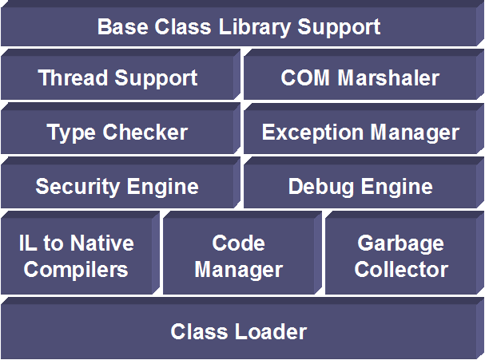
Common Language Runtime
Manages running code
  Verifies type safety
  Provides garbage collection, error handling
  Code access security for semi-trusted code
Provides common type system
  Value types – integer, float, user defined, etc)
  Reference types – Objects, Interfaces
Provides access to system resources
  Native API, COM, etc.
Notes:
Net classes utilize COM+ services
Transactions, Object pooling, etc…
Native DLLs
Using platform invoke
Runtime marshalling
Controlled through attributes

Slide 28
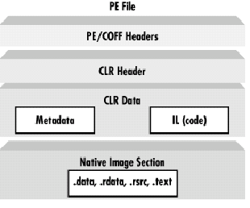
.NET Portable Executable (PE) Files
A Windows executable, EXE or DLL must conform to the PE file format, which is derivative of the Microsoft Common Object File Format (COFF).
Any compiler that wants to generate Windows executables must obey the PE/COFF specification.
A .NET PE file consist of 4 parts as shown in the Figure.
Notes:
Extends the published Microsoft PE and Common Object File Format
There is no need for type libraries or IDL. The runtime locates and extracts the metadata from the file

Slide 29
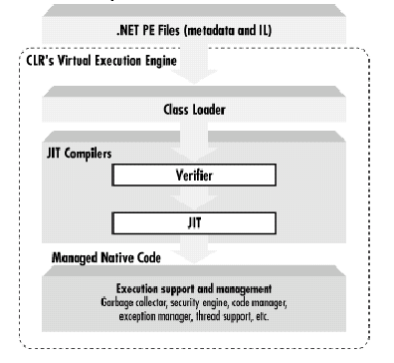
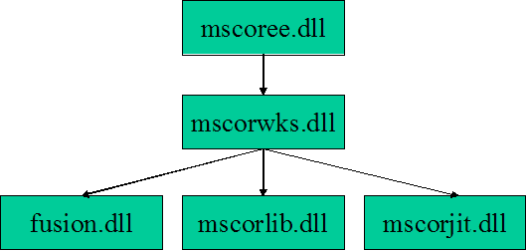
How CLR acts as a Virtual Machine?
mscoree.dll (execution engine)
mscorwks.dll (does most initialization)
mscorjit.dll (contains JIT)
mscorlib.dll (BCL)
fusion.dll (assembly binding)
Notes:
Jit compilation: only necessary codes are compiled and stored native codes during execution
Activate objects
Performs security checks on them
Lays them out in memory
Execute them
Garbage-collects them

Slide 30
Common Language Runtime
The Common Language Runtime (CLR) consists of three main components:
  A type system, which supports many of the types and operations found in modern programming languages.
  A metadata system, which allows metadata to be persisted with types at compile time and then interrogated by the execution system at run time.
  An execution system, which executes .NET Framework programs, utilizing the metadata system information to perform services such as memory management.

Slide 31
Common Language Runtime
The following figure shows one view of the relationship between elements of the runtime.
  At the top of diagram, the source file may hold a definition of a new type in any .NET languages, such as C#.
  When this file is compiled by a .NET Framework C# compiler, the resulting Microsoft Intermediate Language (MSIL) is saved with the new type's metadata. The metadata format used is independent of the programming language in which the type was defined.
  Once the MSIL for this new type exists, other source files, possibly written in other languages, such as C++, Eiffel, Python, or Visual Basic®, can import this file.
  At runtime, the execution system compiles, loads, and starts executing an MSIL file. References to a type defined in a different MSIL file cause that file to be loaded, its metadata is read, and then instances of the new type can be exposed to the runtime.

Slide 32
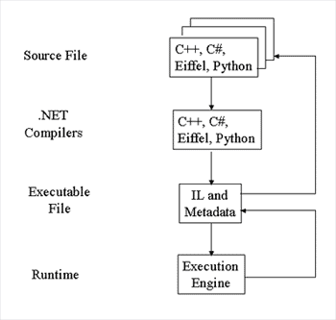
Common Language Runtime

Slide 33
Execution scheme of .NET
Source code
Compiler
IL & Metadata
Class Libraries
(IL & Metadata)
Class Loader
JIT Compiler
with optional
verification
Trusted,
pre-JITed
code only
Call to an
uncompiled
method
Managed Native Code
Runtime
Engine
Execution
Notes:
Схема трансляции в .NET
На слайде представлена общая схема трансляции в .NET (рисунок адаптирован из статьи Дж.Рихтера, опубликованной в сентябрьском выпуске 2000 года журнала MSDN Magazine).
Поскольку опасность замедления учитывалась с самого начала разработки .NET, промежуточное представление было спроектировано таким образом, чтобы облегчить трансляцию в машинные коды на ходу (just-in-time compiling) - в отличие, например, от Java bytecode, который разрабатывался с прицелом на интерпретацию.
Это дало возможность равномерно распределить замедление при запуске, так как обычно компилируется не вся библиотека, а только тот метод, который вызывается, и повторной компиляции одного и того же метода не производится.Таким образом, при первичном запуске приложения нет необходимости дожидаться полной компиляции, достаточно откомпилировать первый запускаемый метод.
На каждой платформе Microsoft планирует создавать два JIT-компилятора - обычный и упрощенный (без оптимизаций). На платформах с ограниченными ресурсами, возможно, будет поддержан только упрощенный компилятор, так как он требует меньше памяти.

Slide 34
.NET Concept
Source Code
Source Code partially compiled to MSIL
Source code written in various languages
MSIL runs on CLR – an implementation of the CLS standard
CLR available for various devices – the use of the Compact Framework
Compiled Code
MSIL Code
CLR
Compiled Code
Platform
Platform
Personal Computer
.NET Enabled Devices
Personal Computer

Slide 35
Language interoperability
When striving for language interoperability, the basic issues remain. Some form of agreement about the representation of data types must be adopted.
  In the CORBA world, the Object Management Architecture defines the concepts of object and type, and the CORBA specification quantifies these concepts.
  In the .NET Framework, the common language runtime type system describes the types within the system.
The common language runtime type system is divided into two subsystems:
  Value types: A variable of value types directly contains only an object with the value.
  Reference types: A variable of reference type directly contains a reference to an object. Another variable many contain a reference to the same object.

Slide 36
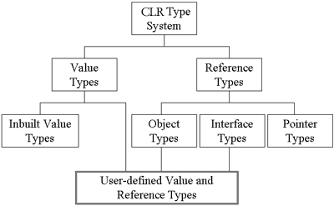
Common language runtime type system

Slide 37
Metadata
Metadata is the essential link that bridges the runtime type system and the execution engine. Currently, two significant problems exist with many component-based programming systems:
  Information about the component (its metadata) is often not stored with the component. Rather, metadata is often stored in auxiliary files, such as interface definition language (IDL) files, type libraries, interface repositories, implementation repositories, and the Registry. The .NET common language runtime stores metadata with types to avoid this issue.
  Metadata facilities are primitive. Most facilities only allow developers to specify the syntax of an interface, but not its semantics. The .NET Framework common language runtime addresses this problem by providing a standardized metadata extension system known as custom attributes.

Slide 38
Common Language Specification
Compilers targeting the .NET Framework describe the types they produce with metadata for two reasons:
  Metadata permits types defined in one language to be usable in another language. This facility ensures language interoperability in the common language runtime.
  The execution engine requires metadata to manage objects. Managing objects includes requirements such as memory management.
If the common language runtime can be described as the union of many programming language features, the common language specification (CLS) is a subset of these features. The subset is not the set of all features common to all languages. Rather it is a set of features common to many programming languages.

Slide 39
.NET security
Security is an essential part of .NET.
Means of ensuring safety:
  Safe type system (type verification): .NET code is subject to verification.
  Code authenticity check: .NET assembly is signed using 128-bit public key cryptography.
  Resource access authorization
  Declarative/Imperative security
  Security policy:
    Access policies
    Roles (based on the roles)
Increased security role for remote execution
Cryptographic security methods available for embedding into user applications
Notes:
Безопасность в .NET
Безопасность является краеугольным камнем .NET. На всех этапах создания и выполнения программ происходят самые различные проверки - от проверки прав на доступ к коду до разрешений на ресурсы. Вот некоторые из типов проверок безопасности:
Безопасность типов. Программы, гарантирующие безопасность данных, обращаются только к тем участкам памяти, которые были выделены для них. Доступ к объектам осуществляется только через специальные интерфейсы, в которые встроены проверка безопасности. В целом, безопасность типов может быть проверена не всегда; однако ее наличие гарантирует невозможность одной из самых распространенных атак (чтение указателя большего размера, чем выделенная память).
Подлинность кода. Загрузчик классов сохраняет информацию об исходных текстов всех классов, которые были загружены. Таким образом, можно восстановить некоторые атрибуты кода (откуда загружен код, кто является атором и т.п.). Эту информацию можно использовать для дачи прав на запуск.
Разрешения на доступ к ресурсам. Ресурсы обычно ассоциированы с системой. В качестве ресурсов могут выступать файлы, сетевые соединения, право вызова unmanaged APIs. Отметим, что права доступа проверяются не только для вызвавшего assembly, но и для всех прочих, находящихся в данный момент в стеке вызовов.

Slide 40
.NET vs. COM
COM provides a way for components to integrate. However, each component has to provide plumbing and objects could not directly interact.
With .NET framework common language runtime, components are built on a common platform. No plumbing is needed and objects could directly interact.
Though COM permits you to integrate binary components developed using any language, it does require you to obey the COM identity, lifetime, and binary layout rules and write the plumbing code that is required to create a COM component
.NET class can be exported as a COM object

Slide 41
.NET vs. COM
Eliminates COM plumbing
  Registration ➔self describing components
  GUIDs (Globally Unique Identifier) ➔ hierarchical namespaces
  .IDL files ➔ source code to metadata
  HRESULTs (a coded numerical value assigned to a specific exception) ➔ structured exceptions
  IUnknown (The IUnknown interface is the basis of all COM interfaces.) ➔ root object class
  AddRef/Release ➔garbage collector
  CoCreateInstance (This function creates on the local system a single uninitialized object of the class associated with a specified class identifier.) ➔ new operator

Slide 42
CLR vs. JVM
CLR | JVM (CORBA IDL, CORBA ORB)
IL code and metadata | bytecode
JIT compiler/install time Code Gen | Interpreted/JIT compiler
Platform-specific, dependent on platform-specific class library; any computer architecture, | Any platform, any computer architecture
provides a set of framework classes and lets every language use it | Bytecode Support different language by native call
They are both a runtime infrastructure and platform differences are hiding from the users.

